Slide 1
Twitter Airline Sentiment Analysis
Aditya Chandel
Keval Shah
Anand Bora

Slide 2
Content
Problem
Dataset
Exploratory Analysis
Machine Learning Models
Conclusion

Slide 3
Problem

Slide 4
Problem?
Analyzing the tweet sentiments of travelers who flew on U.S. airlines in the month of February 2015.
We want to answers various questions, like:
Text analysis of the user tweets to find out the reasons behind the user’s sentiments.
A language model for analyzing the sentiments using machine learning techniques.
Find out which airlines which provide best and worst customer satisfaction.
Get the most discussed topics among various airlines.
Other interesting stats and graphs.

Slide 5
Dataset

Slide 6
Twitter Data (Airline)
15000 users’ tweets and metadata; about their reaction/opinion/review about a particular airline.
CSV format.
Tweets are labeled as Positive, Neutral, Negative by human labelers.
Reason for negative sentiment (“Late Flight”, “Rude Staff”, etc.) is also in the dataset.
Scraped in the month of February 2015.

Slide 7
Twitter Data (Airline)
The fields in the Tweets.csv file are:
tweet_id
airline_sentiment
negativereason
airline
name
text
tweet_coord
tweet_created
tweet_location
user_timezone

Slide 8
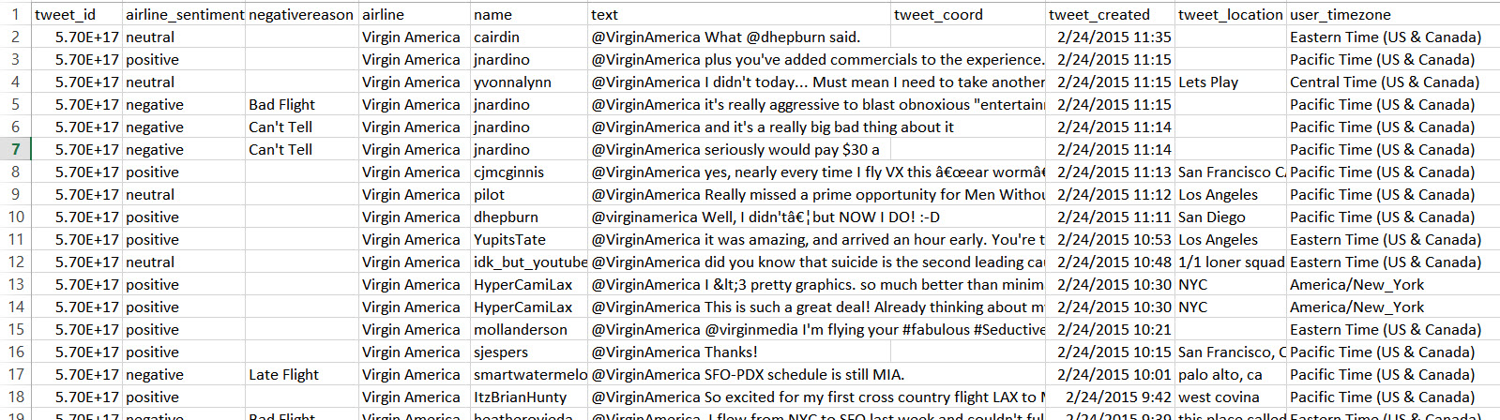
Twitter Data (Airline)

Slide 9
Exploratory Analysis

Slide 10
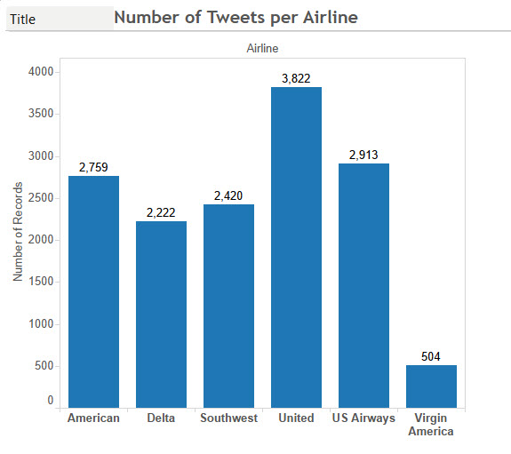
Tweets Per Airlines

Slide 11
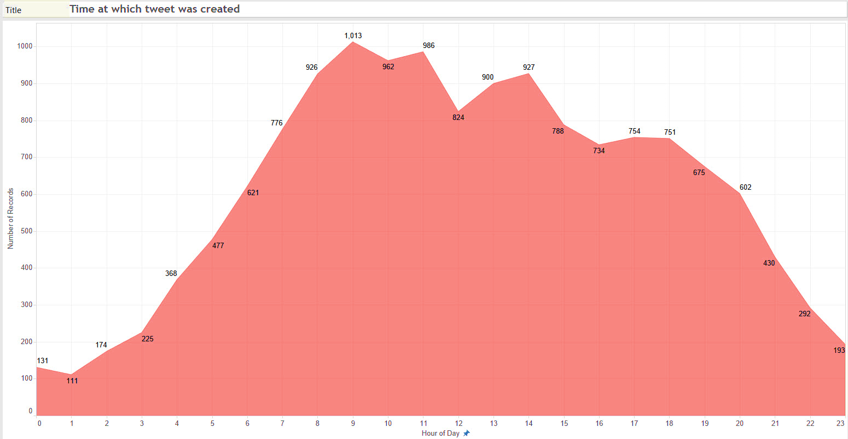
Time at which tweets were created

Slide 12
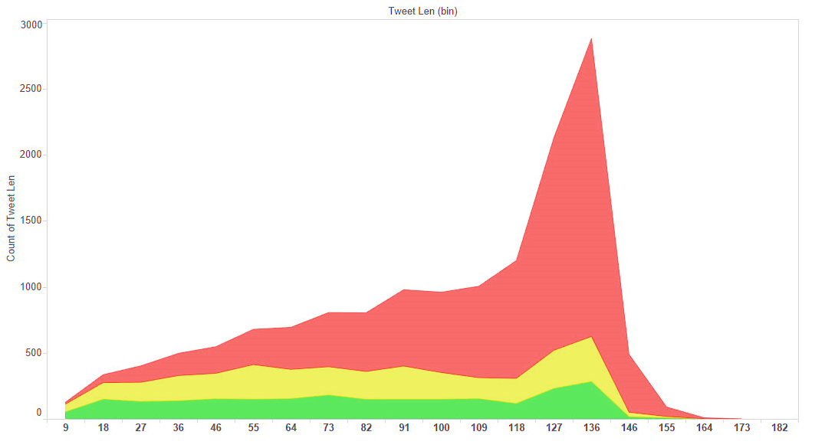

Length of Tweets

Slide 13
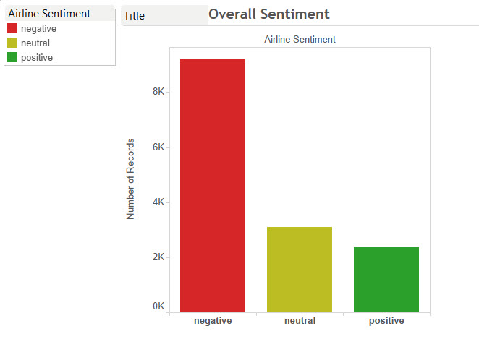
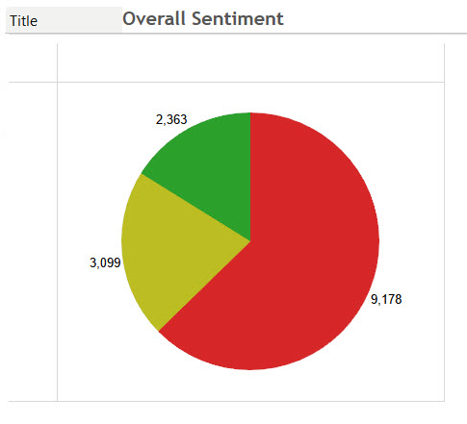
Overall Sentiments

Slide 14
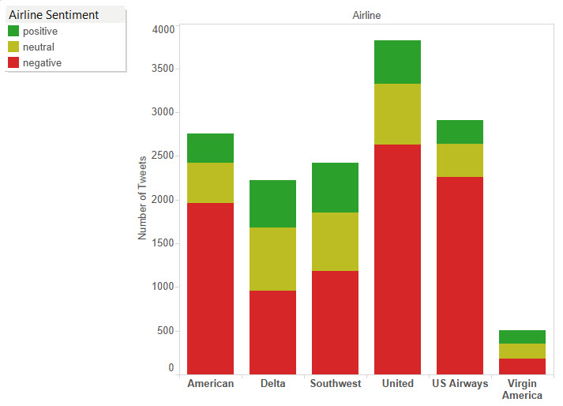
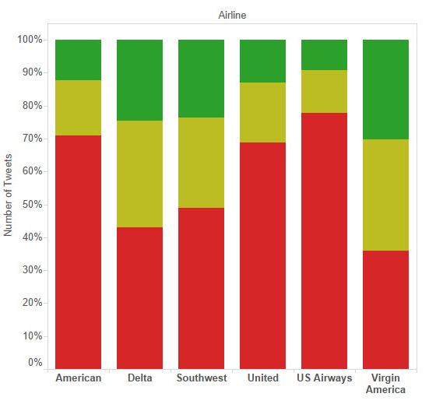
Sentiment for each Airline

Slide 15
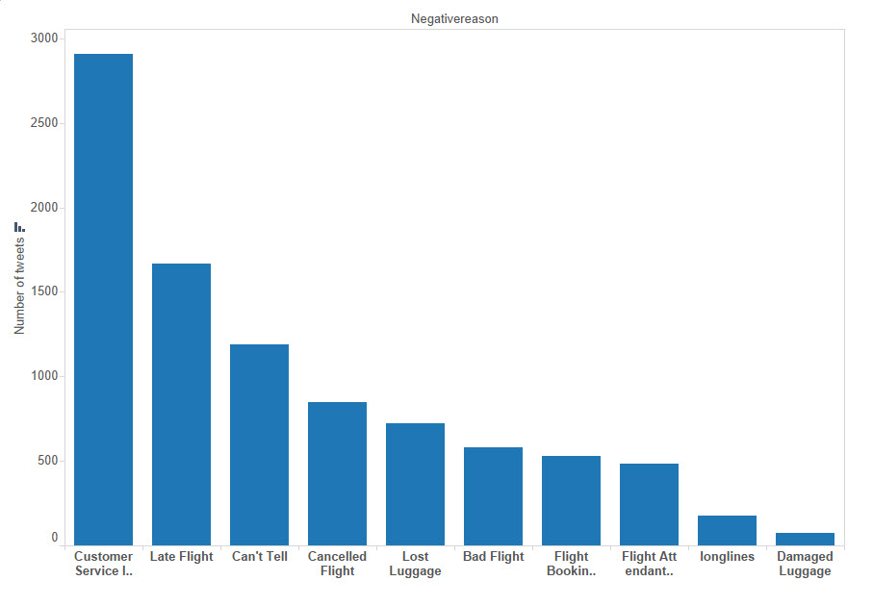
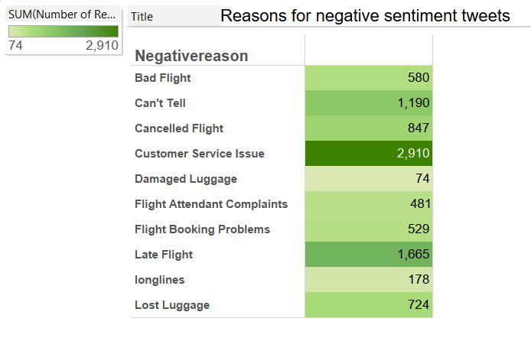
Reason for Negative Sentiment

Slide 16
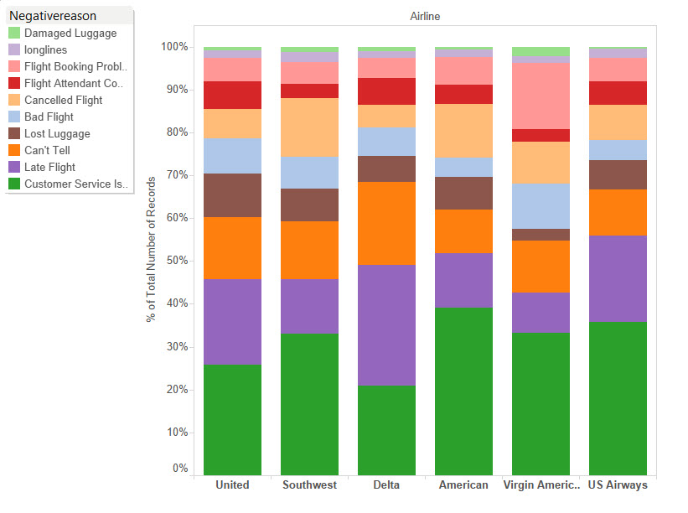
Reason for Negative Sentiment by Airline
Conclusions:
American Airline has worst customer service.
Delta has most late flights.
Southwest and American has most cancelled flights.
United is top in lost luggage.
Virgin has most flight booking problem.

Slide 17
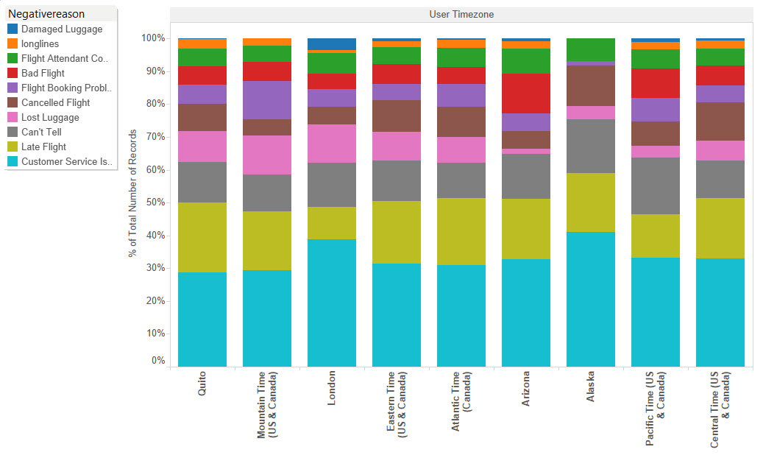
Negative Sentiment Reason by TimeZone

Slide 18
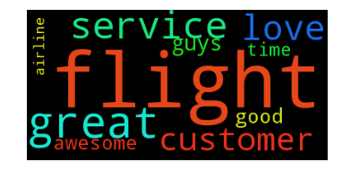
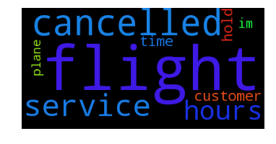
Top words in Positive & Negative Sentiment
Top 10 words in +ve sentiment
Top 10 words in -ve sentiment

Slide 19
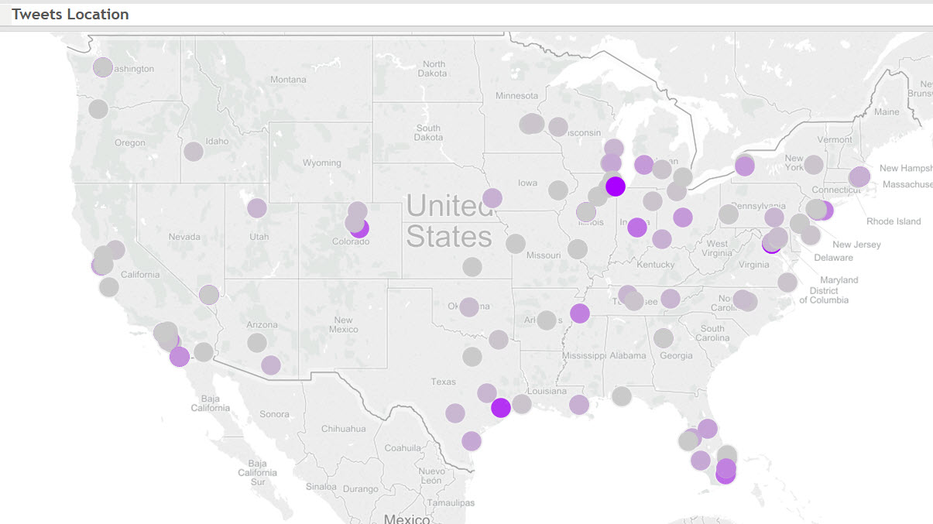
Tweet Location

Slide 20
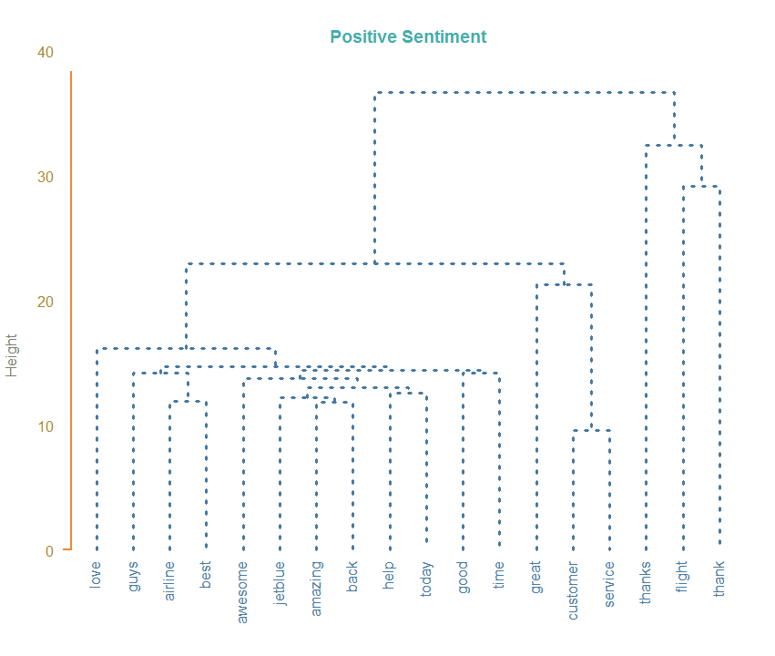
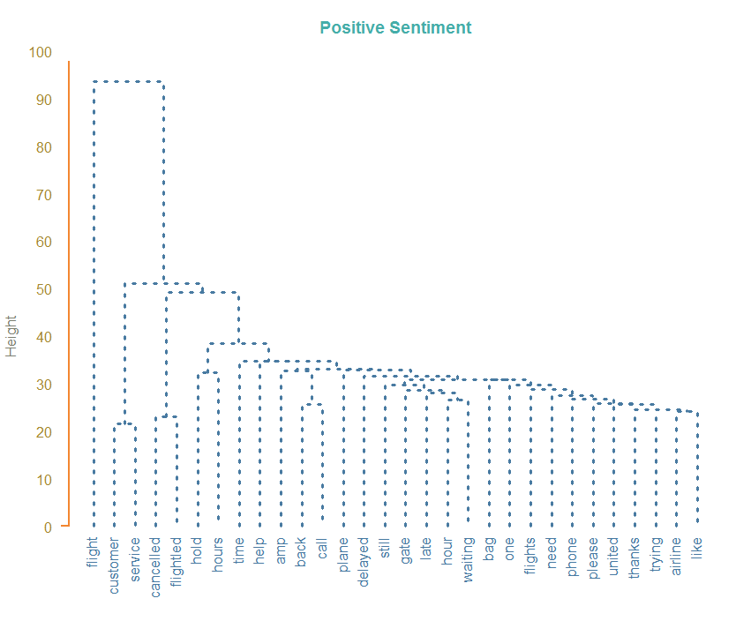
Word Associations (Dendrogram)
Negative Sentiment

Slide 21
Machine Learning Models

Slide 22
Build Machine Learning Classifiers
Goal: To build a model for classifying flight tweets into destination class (i.e. positive, negative and neutral) using the features extracted from tweet text.
Approach:
Load tweets into Sframe.
Tweets Preprocessing.
Feature Extraction.
Machine Learning (Classification).

Slide 23
Build Machine Learning Classifiers
Tweet Preprocessing:
Remove punctuations.
Convert to lower case.
Convert www.* or https://* to URL
Convert @username to AT_USER
Remove additional white spaces
Replace #word with word

Slide 24
Build Machine Learning Classifiers
Building Feature Vector from Tweets (Feature Extraction):
Replace words with two or more occurrences.
Strip punctuations.
Remove words not starting with alphabets.
Remove Stop Words.

Slide 25
Build Machine Learning Classifiers
Train classifiers using processed tweets & extracted features.
Multi-class classification problem.
Classifiers used:
Logistic Regression
Random Forest
Boosted Tree
Decision Tree
10 Iterations.
10-fold Cross Validation.
Calculate Accuracy, AUC, F1 Score, Precision, Recall.

Slide 26
Results / Evaluation

Slide 27
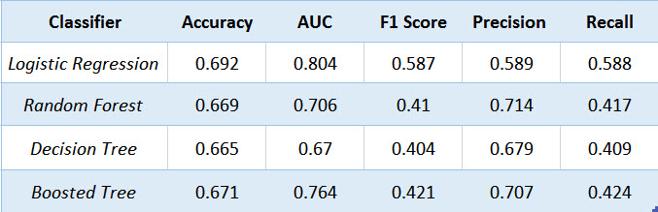
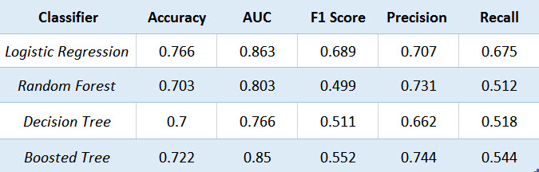
Evaluation (Uni-Gram Model)
Logistic Regression: Best Accuracy, AUC, Recall and F1 score.
Boosted Tree: Best Precision.

Slide 28
Evaluation (Bi-Gram Model)
10% increase in performance over Uni-Gram Model.
Logistic Regression: Best Accuracy, AUC, Recall and F1 score.
Boosted Tree: Best Precision.

Slide 29
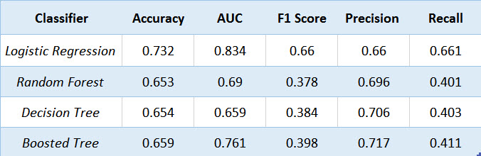
Evaluation (TF-IDF Model)
All TF-IDF classifiers performed worse than non TF-IDF models.
10-15% drop in performance over Bi-gram model.
Reason: Limited characters in tweets (<140 words). So all the words used have high significance and play role in classification.

Slide 30
Summary & Conclusion

Slide 31
Summary
First we performed thorough exploratory analysis on the data to find interesting information about airlines, like:
Flights with best and worst customer satisfaction.
Reasons for negative sentiment.
Reasons for negative sentiment by airlines.
Top negative and positive words.
Word associations (Dendrogram)
Then we built various machine learning models to classify tweets to positive, neutral and negative categories, and to check if they confirm with human labeling.
Bi-Gram model performed best, with classification accuracy of 76% and AUC of 84%.
TF-IDF model performed worst.
We have carried out what we had proposed in our proposal.

Slide 32
Thank You

